Slide 1

INTERNET OF THINGS-INTERNSHIP
“It's the beginning of machines taking over the world ”
NAME : SUNKARA VENKATESH
College Name: Gitam university - BENGALURU
BRANCH : ELECTRONICS AND COMMUNICATION ENGINEERING

Slide 2
Introduction to C
Topics in c programming language
1.structure of c programming
2.Data types in C
3.Operators in C
4.Decision Making
5.Loops
6.Functions
7.Pointers
8. Arrays
9.Macros
10.File handling in C

Slide 3
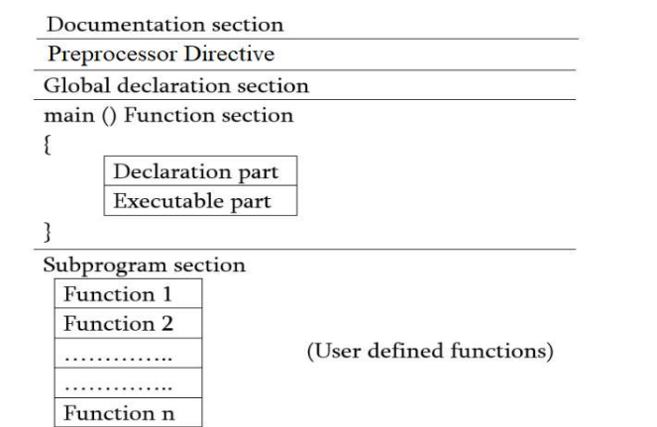
Structure of c programming
#include<stdio.h>
Int main();
{
int a , int b,sum;
scanf(“%d %d ”,&a,&b);
Printf(“enter the values of a:”);
sum = a+b;
Printf(“The sum is %d”,a,b);
Return 0;
}

Slide 4
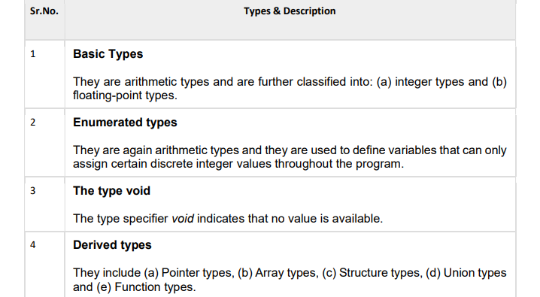
DATA TYPES IN C
Data types in c refer to an extensive system used for declaring variables or functions of different types. The type of a variable determines how much space it occupies in storage and how the bit pattern stored is interpreted.

Slide 5
OPERATORS IN C
An operator is a symbol that tells the compiler to perform specific mathematical or logical functions. C language is rich in built-in operators and provides the following types of operators −
Arithmetic Operators
Relational Operators
Logical Operators
Bitwise Operators
Assignment Operators
Conditional Operators(ternary operator)
Misc Operators

Slide 6
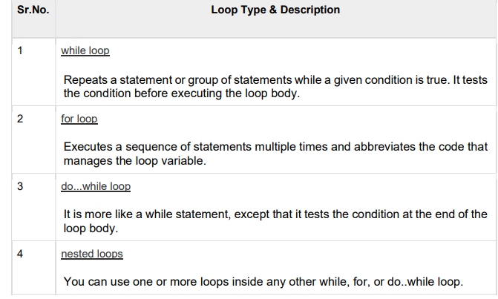
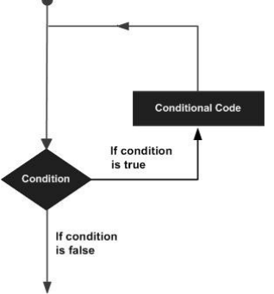
LOOPS
A loop statement allows us to execute a statement or group of statements multiple times.

Slide 7
MACROS
Macro in C programming is known as the piece of code defined with the help of the #define directive.
Macros in C are very useful at multiple places to replace the piece of code with a single value of the macro.
Syntax:
#define name constants
EX: #define LED 3

Slide 8
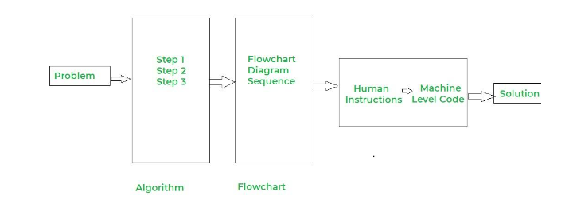
EMBEDDED C
Embedded C is a set of language extensions for the C programming language designed to program microcontrollers
Embedded C is hardware dependent language
Applications:
Robots, Vehicle tracking systems, smart monitoring systems are some of the applications.

Slide 9
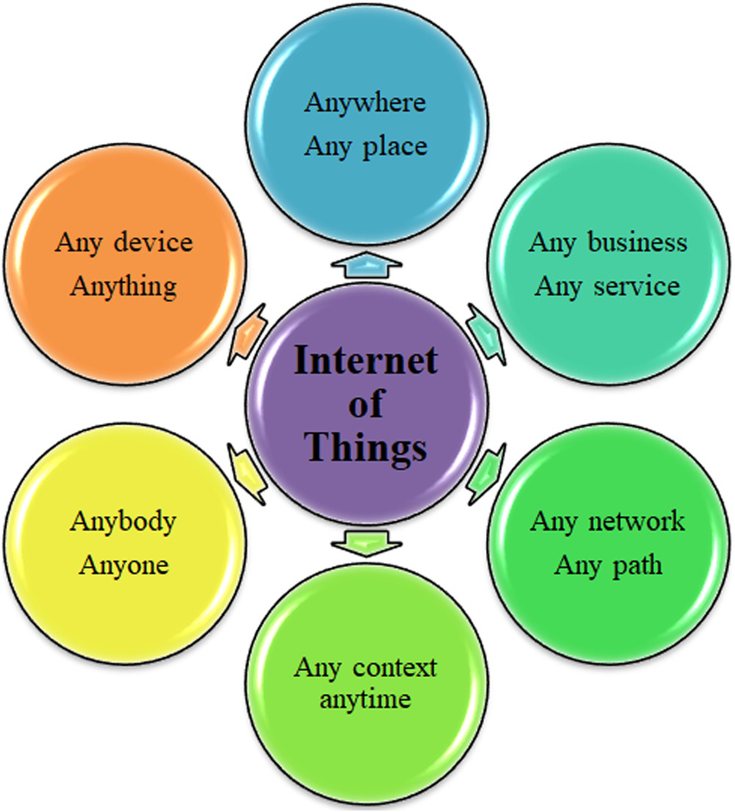
INTERNET OF THINGS
What is IOT?
The network of physical object that contain embedded technology to communicate and interact with their internal states or the external environment.

Slide 10
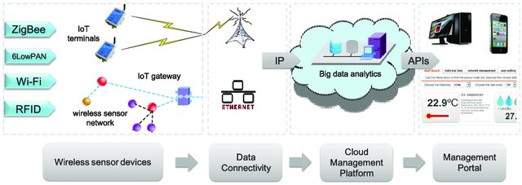
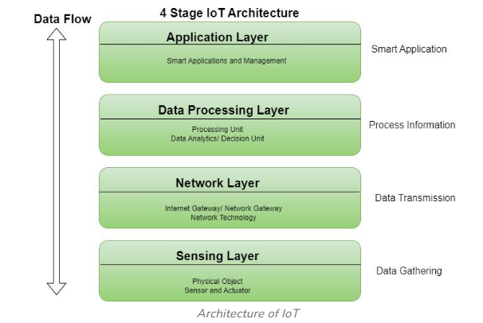
IOT END TO END FLOW

Slide 11
CHALLENGES IN IOT
Security
Scalability
Reliability
Connectivity
Data management
Cross platform capability
Integration

Slide 12

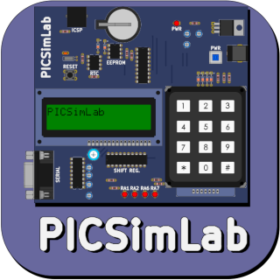


PROJECT
IOT based Home Automation Solution
Tools used in project:
1.Aurdino IDE
2.Picsimlab
3.Blynk IOT App
4. Virtual serial port Tools

Slide 13
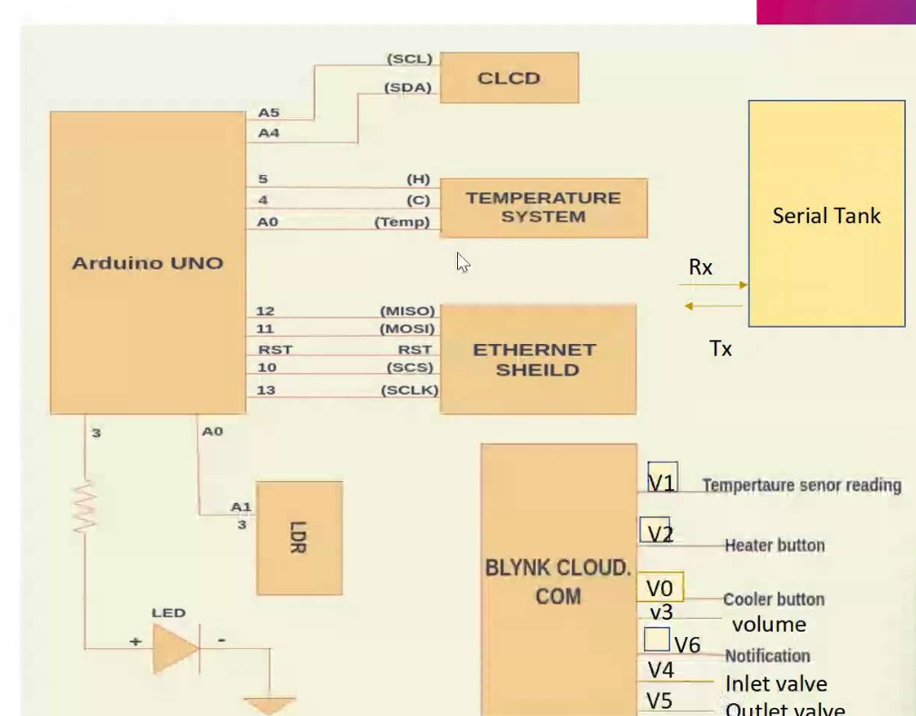
REQUIREMENTS AND DESIGN FOR PROJECT
Garden lights control
Temperature Control System
water tank inlet and outlet valve control

Slide 14
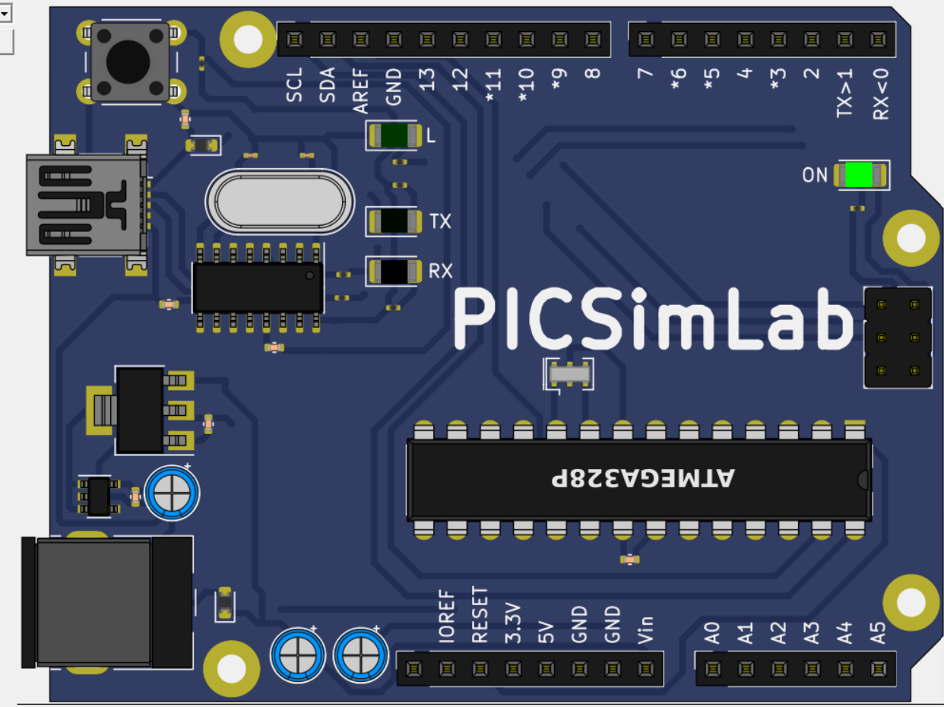
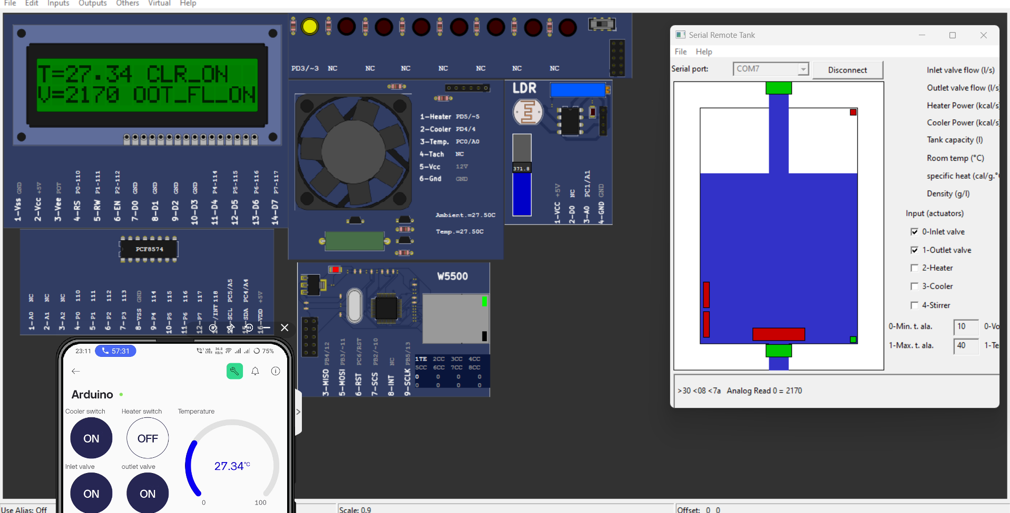
PROJECT SIMULATION IMAGES

Slide 15
CONCLUSION
Using BLYNK IOT application and Pic-Simlab simulator, simulated home automation, where LED, temperature system, Serial tank resembles Light, Heater, Cooler and Water tank in real time.
CLCD acts like a dash board used for displaying the events, Widgets from Blynk IOT app like button widgets are used to control heater, cooler and inlet valve, outlet valve.
Gauge widgets to display the temperature.

